Slide 1
Digital Audio Signal Processing DASP Chapter-5:
Acoustic Echo & Feedback Cancellation
Marc Moonen
Dept. E.E./ESAT-STADIUS, KU Leuven
marc.moonen@kuleuven.be
homes.esat.kuleuven.be/~moonen/

Slide 2
Outline
Acoustic Echo Cancellation (AEC)
Intro/Acoustic Channels
Adaptive Filters for AEC
Control Algorithm
Stereo AEC
Acoustic Feedback Control (AFC)
Intro/Nyquist Stability & Maximum Stable Gain
AFC Methods
Notch-Filter-Based Howling Suppression (NHS)
Adaptive Feedback Cancellation (AFC)

Slide 3
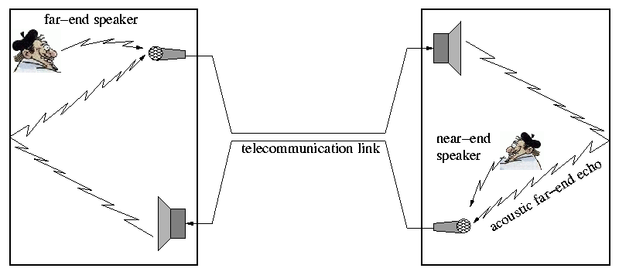
Introduction
Acoustic Echo Cancellation (AEC)
Suppress echo..
To guarantee normal conversation conditions
To prevent the closed-loop system from becoming unstable
Applications
Teleconferencing
Hands-free telephony
Handsets, ..

Slide 4
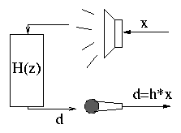
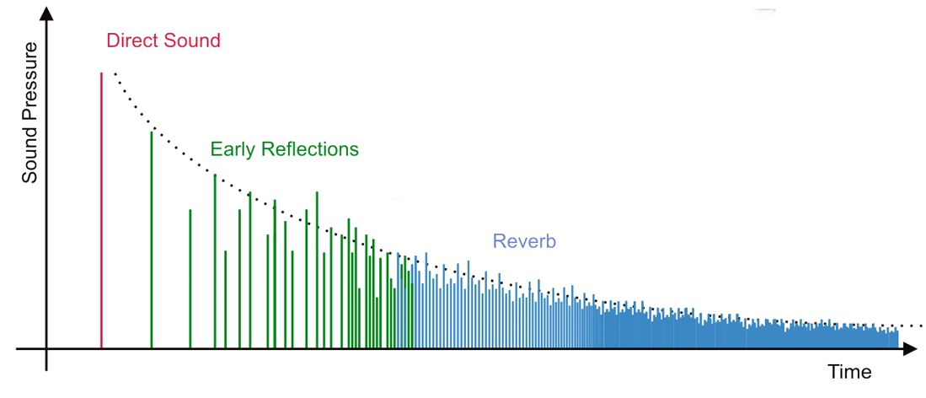
Introduction: Acoustic Channels
Loudspeaker + acoustic path + microphone can be modeled with sufficient accuracy as a linear filtering operation
PS: Loudspeaker often introduces non-linear distortion,
not taken into account here
Acoustic path is represented by the
acoustic impulse response
First there is a dead time. Then come the direct path impulse and some early reflections, which depend on the geometry of the room. Finally there is an exponentially decaying tail called reverberation, coming from multiple reflections on walls, objects,... Reverberation mainly depends on ‘reflectivity’ (rather than geometry) of the room…

Slide 5
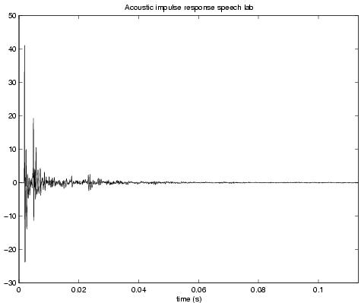
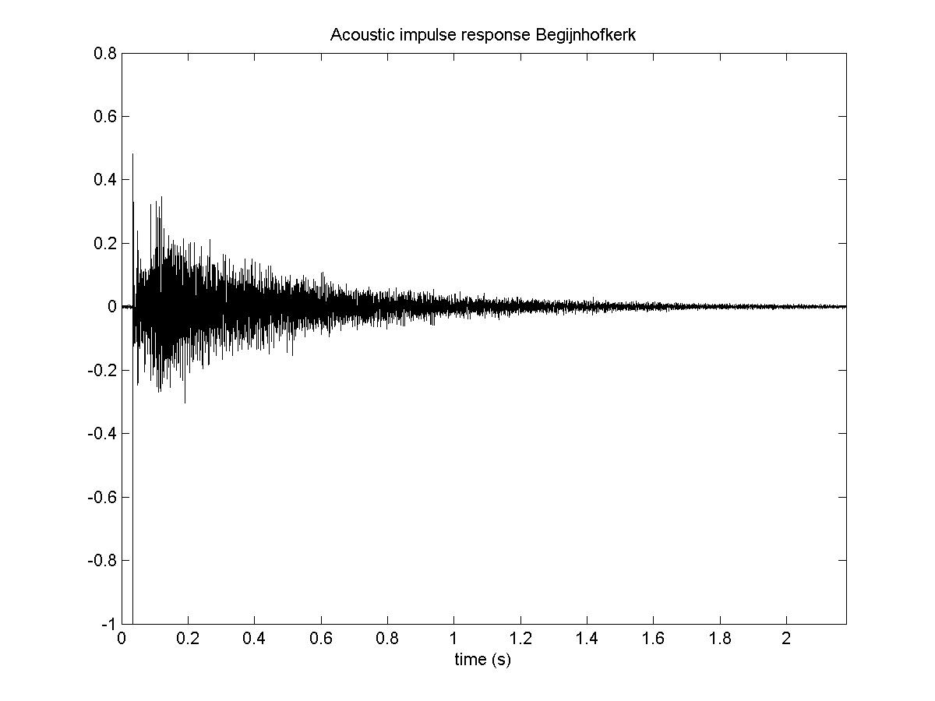
Introduction: Acoustic Channels
To characterize the ‘reflectivity’ of a room the reverberation
time ‘RT60’ is defined
RT60 = time which the sound pressure level or intensity needs
to decay to -60dB of its original value
For a typical office room RT60 is between 100 and 400 ms, for a church RT60 can be several seconds
PS: Acoustic room impulse responses are highly time-varying !!!!
PS: Acoustic room impulse responses are position dependent !!!!
ESAT speech laboratory
RT60 ≈ 120 ms
Begijnhofkerk Leuven
RT60 ≈ 3730 ms

Slide 6
Acoustic Channels
Acoustic Impulse Response : FIR or IIR ?
If the acoustic impulse response is modeled as an..
FIR filter → hundreds/thousands of filter taps are needed
IIR filter → filter order can be reduced, but still hundreds of filter
coeffs (num. + denom.) may be needed (sigh!)
Furthermore...
In a speech comms set-up the acoustics are highly time-varying, hence adaptive filtering techniques are called for (see DSP-CIS):
FIR adaptive filters : simple adaptation rules, no local minima,..
IIR adaptive filters : more complex adaptation, local minima, have to monitor stability, ..
Hence FIR models are used in practice

Slide 7
Outline
Acoustic Echo Cancellation (AEC)
Intro/Acoustic channels
Adaptive filters for AEC
Control Algorithm
Stereo AEC
Acoustic Feedback Control (AFC)
Intro/Nyquist Stability & Maximum Stable Gain
AFC Methods
Notch-Filter-Based Howling Suppression (NHS)
Adaptive Feedback Cancellation (AFC)

Slide 8
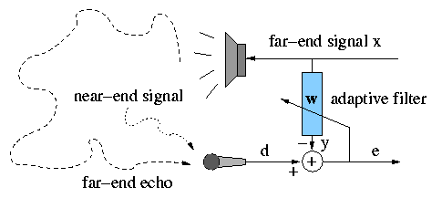
Adaptive filters for AEC
Basic set-up
Adaptive filter produces a model for acoustic room impulse response +
an estimate of the echo contribution in microphone signal, which is
then subtracted from the microphone signal
Thanks to adaptivity
time-varying acoustics can be tracked
performance superior to performance of `conventional’ techniques (e.g. voice controlled switching, loss control, etc.)

Slide 9
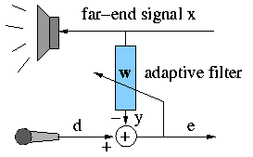
Adaptive filters for AEC: NLMS
NLMS update equations
in which
N is # filter taps, k is the discrete-time index
μ is the adaptation stepsize and δ is a regularization parameter

Slide 10
Adaptive filters for AEC: NLMS
Pros and cons of NLMS
+ cheap algorithm : O(N)
+ small input/output delay (= 1 sample)
for colored far-end signals (such as speech) convergence of the NLMS algorithm is slow
(cfr λ_{max} versus λ_{min}, etc…., see DSP-CIS)
large N then means even slower convergence
¤ NLMS is thus often used for the cancellation of short echo paths

Slide 11
Adaptive filters for AEC
As some input/output delay is acceptable in AEC (e.g. ITU says 16ms), algorithms can be derived that are even cheaper than NLMS, by exchanging implementation cost for extra processing delay, sometimes even with improved performance :
Frequency-domain adaptive filtering (FDAF)
Partitioned Block FDAF (PB-FDAF)
+ cost reduction
+ optimal (stepsize) tuning for each subband/frequency bin
separately results in improved performance

Slide 12
Adaptive filters for AEC: Block-LMS
To derive the frequency-domain adaptive filter the BLMS algorithm is considered first
in which
N is # filter taps, L is block length, n is block time index
BLMS = gradient averaging over block of L samples (i.o. 1 sample in LMS)

Slide 13
Adaptive filters for AEC: Block-LMS
Both the BLMS convolution and correlation operation are computationally demanding. They can be implemented more efficiently in the frequency domain using fast convolution techniques, i.e. overlap-save/overlap-add :
convolution
overlap-save
correlation
with
M-point DFT-matrix

Slide 14
Adaptive filters for AEC: FDAF
Overlap-save FDAF
Will only work if
(M is DFT-size)

Slide 15
Adaptive filters for AEC: FDAF
¤ Typical parameter setting for the FDAF :
¤ FDAF is functionally equivalent to BLMS (!)
+ FDAF is significantly cheaper than (B)LMS (cfr FFT/IFFT i.o. DFT/IDFT)
for a typical parameter setting If N=1024 :
- Input/output delay is equal to 2L-1=2N-1, which may be unacceptably large for realistic parameter settings : e.g. if N=1024 and fs=8000Hz → delay is 256 ms !

Slide 16
Adaptive filters for AEC: PB-FDAF
Overlap-save PB-FDAF : N-tap filter split into (N/P) filter sections, P-taps each, then apply overlap-save to each section
(`P takes the place of N’).
Will only work if

Slide 17
Adaptive filters for AEC: PB-FDAF
¤ Typical parameter setting :
¤ PB-FDAF is intermediate between LMS and FDAF (N/P=1)
¤ PB-FDAF is functionally equivalent to BLMS
+ PB-FDAF is cheaper than (B)LMS :
If N=1024, P=L=128, M=256 ➔
+ Input/output delay is 2L-1 which can be chosen small, in the example above the delay is 32 ms, if fs=8000Hz
+ Instead of a simple stepsize μ, ‘subband’ dependent stepsizes μ_{i} can be applied to increase convergence speed
¤ used in commercial AECs

Slide 18
Outline
Acoustic Echo Cancellation (AEC)
Intro/Acoustic channels
Adaptive filters for AEC
Control Algorithm
Stereo AEC
Acoustic Feedback Control (AFC)
Intro/Nyquist Stability & Maximum Stable Gain
AFC Methods
Notch-Filter-Based Howling Suppression (NHS)
Adaptive Feedback Cancellation (AFC)

Slide 19
Control Algorithm
Adaptation speed (μ ) in LMS-type algorithms should be adjusted…
to the far-end signal power, in order to avoid instability of the adaptive filter (see DSP-CIS) → stepsize normalization (e.g. NLMS)
to the amount of near-end activity, in order to prevent the filter to move away from the optimal solution (see DSP-CIS on ‘excess MSE’)
→ double-talk detection
Double talk refers to the situation where both the far-end and the
near-end speaker are active.

Slide 20
Control Algorithm
3 modes of operation:
Near-end activity (single or double talk) (Ed large) →
No near-end activity, only far-end activity (Ex large, Ed small) →
No near-end activity, no far-end activity (Ex small, Ed small) →
→ FILT
→ FILT+ADAPT
→ NOP
Ex is short-time energy of
the far-end signal (loudspeaker)
Ed is short-time energy of
the desired signal (microphone)

Slide 21
Control Algorithm
Double-talk Detection (DTD)
Problem: detection of (near-end) speech during (far-end) speech
Desired properties: Limited number of false alarms, small delay, low complexity, etc...
Different approaches exist, which are based on energy, correlation, spectral contents, etc…
Example: Energy-based DTD
Method-1
If Ed > τ Ex → double talk (τ is a chosen threshold)
Method-2
If ρ > 1 → double talk (with )

Slide 22
Outline
Acoustic Echo Cancellation (AEC)
Intro/Acoustic channels
Adaptive filters for AEC
Control Algorithm
Stereo AEC
Acoustic Feedback Control (AFC)
Intro/Nyquist Stability & Maximum Stable Gain
AFC Methods
Notch-Filter-Based Howling Suppression (NHS)
Adaptive Feedback Cancellation (AFC)

Slide 23
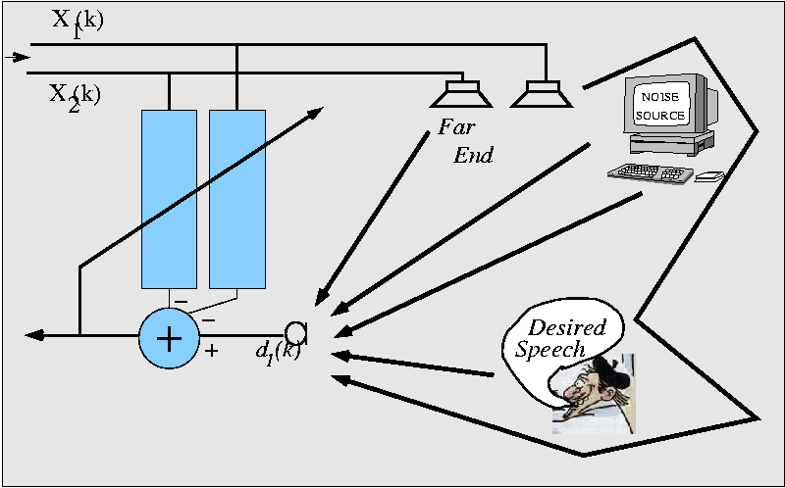
Stereo-AEC
Stereo-AEC Conditioning Problem:
S-AEC input vectors are
Mono : autocorrelation of x-signal (e.g. speech) has
an impact on convergence (see DSP-CIS)
Stereo : also cross-correlation between signals x1 and x2
plays a role now…
➔ Large(r) eigenvalue spread (λ_{max}>> λ_{min,}, i.e. large(r) condition number)
of correlation matrix -> large(r) impact on convergence !

Slide 24
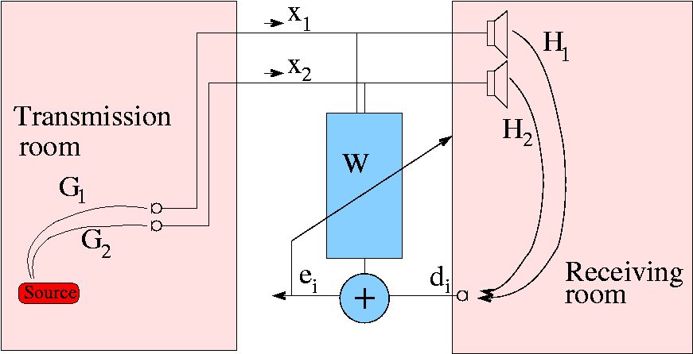
Stereo-AEC
Stereo-AEC Conditioning Problem:
Consider transmission room
impulse responses G1,G2 (length Q)
Assume then :
explain!
Hence filter input correlation matrix will be rank-deficient
(with `null-space’, hence λ_{min}=0, hence worst possible (∞) eigenvalue spread)
Hence LMS converges to a filter vector with spurious contribution
α.[G₂^{T} -G₁^{T}]^{T} (corresponding to non-converging ‘mode’ defined by λ_{min}) , which depends
on transmission room, i.e. G1 & G2, which themselves are time-varying!

Slide 25
Stereo-AEC
In practice :
Hence
So that correlation matrix will be (only) ill-conditioned
(instead of rank-deficient)
…which however is still bad news

Slide 26
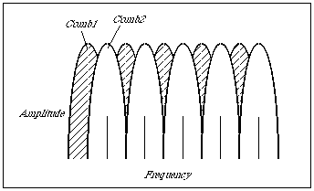
Stereo-AEC
Stereo-AEC Fixes:
Reduce correlation between the loudspeaker signals by…
Complementary comb filters
White noise insertion
Colored (masked) noise insertion (p27)
Non-linear processing (p28)
Comb-1 for x1, comb-2 for x2
Disadvantages :
Signal distortion
Stereo perception may be affected
- In addition : use algorithms that are less sensitive to the
condition number than NLMS, e.g. RLS, ...

Slide 27
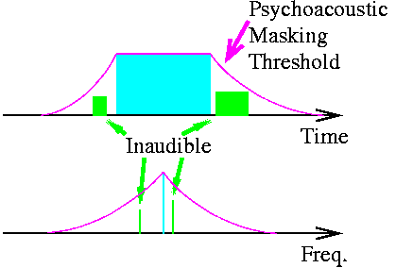
Stereo-AEC
Stereo-AEC Fixes:
Colored noise insertion
Remove all signal content below the masking threshold
Fill with noise (both channels independently)
Correlation between input channels decreases
Poor performance for speech
Good performance for music
Computationally intensive

Slide 28
Stereo-AEC
Stereo-AEC Fixes:
Non-linear processsing
is often a half wave rectifier
is necessary for good performance, but audible
Good results for speech, audible artifacts in music

Slide 29
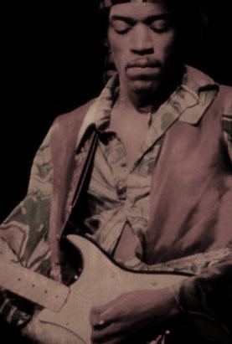
Outline
Acoustic Echo Cancellation (AEC)
Intro/Acoustic channels
Adaptive filters for AEC
Control Algorithm
Stereo AEC
Acoustic Feedback Control (AFC) (*)
Intro/Nyquist Stability & Maximum Stable Gain
AFC Methods
Notch-Filter-Based Howling Suppression (NHS)
Adaptive Feedback Cancellation (AFC)
(*) Reference: T. van Waterschoot & M. Moonen, “Fifty years of acoustic feedback control: state of the art and future challenges,” Proc. IEEE, vol. 99, no. 2, 2011, pp. 288-327.

Slide 30
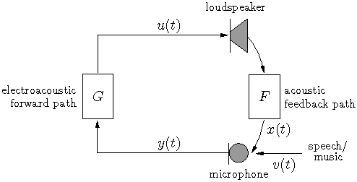
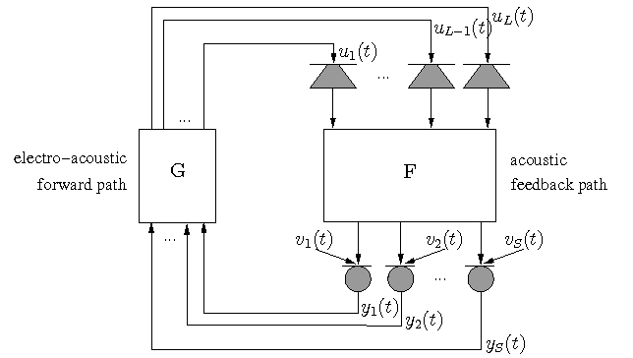
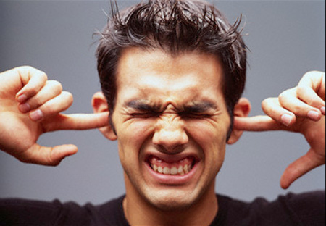
Introduction
Acoustic Feedback Control (AFC)
Single channel AFC =
- One loudspeaker
- One microphone
Multi-channel AFC = ………..
(not treated here)
Applications
Hearing aids
Sound reinforcement

Slide 31
AFC Basics
“Desired” system transfer function:
Closed-loop system transfer function:
Spectral coloration
Acoustic echoes
Risk of instability
Loop response:
Loop gain
Loop phase

Slide 32
AFC Basics
Nyquist stability criterion:
If there exists a radial frequency ω for which
then the closed-loop system is unstable
If the unstable system is excited at the critical frequency ω, then an oscillation at this frequency will occur = howling
Maximum stable gain (MSG):
Maximum forward path gain before instability
Desirable gain margin 2-3 dB (= MSG – actual forward path gain)
if G has flat response
[Schroeder, 1964]
B=bandwidth

Slide 33
AFC Methods
Phase modulation (PM) methods (not addressed here)
Apply frequency/phase modulations in forward path
Spatial filtering methods
Microphone beamforming to reduce direct coupling
(Lecture 2)
Gain reduction methods
(Frequency-dependent) gain reduction after howling detection
Example: Notch-filter-based howling suppression (NHS)
Room modeling methods
Adaptive inverse filtering (AIF): adaptive equalization of acoustic feedback path response (not addressed here)
Adaptive feedback cancellation (AFC): adaptive prediction and subtraction of feedback component in microphone signal
Skip this slide

Slide 34
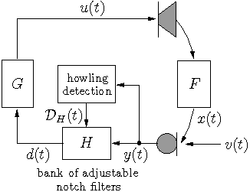
Notch-Filter-Based Howling Suppression (NHS)
Gain reduction after howling detection
NHS subproblems:
Howling detection
Notch filter design
Skip this slide

Slide 35
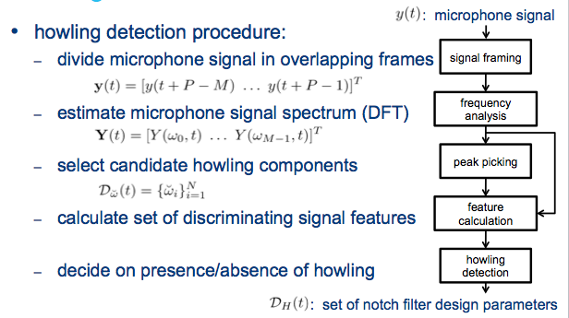
Notch-Filter-Based Howling Suppression (NHS)
Skip this slide

Slide 36
Notch-Filter-Based Howling Suppression (NHS)
Skip this slide

Slide 37
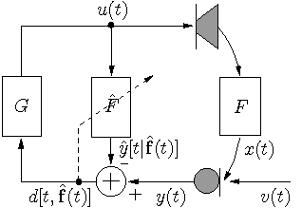
Adaptive Feedback Cancellation (AFC)
Predict and subtract entire feedback signal (i.o. only howling component) in microphone signal
Requires adaptive estimation of acoustic feedback path model
Similar to AEC, but more difficult due to closed signal loop
(-> correlation of loudspeaker
and source signal

Slide 38
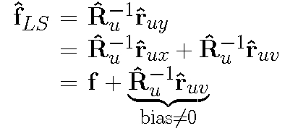
Adaptive Feedback Cancellation (AFC)
AFC correlation problem
Optimal filter (Wiener filter) will have
a non-zero bias
Non-zero bias results in (partial) source signal (v) cancellation
Need decorrelation of loudspeaker and source signal
WF

Slide 39
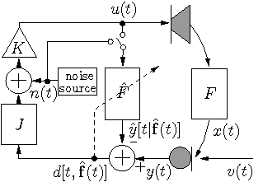
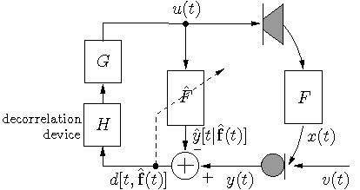
Adaptive Feedback Cancellation (AFC)
Two methods…
1. Decorrelation in the signal loop
Noise injection ➔➔➔➔
Time-varying processing
Nonlinear processing
Forward path delay
Inherent trade-off
between decorrelation
and sound quality

Slide 40
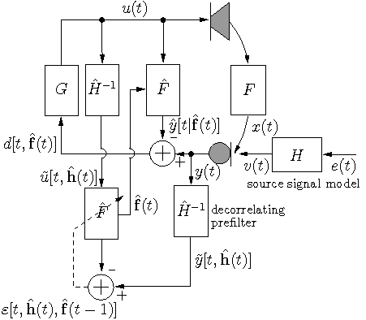
Adaptive Feedback Cancellation (AFC)
2. Decorrelation in the adaptive filtering circuit
Decorrelating prefilters to remove bias in adaptive filter
based on source signal model
Sound quality not compromised
Prediction-error-method (PEM)
(details omitted)
joint estimation of acoustic feedback path and source signal model
25-50% computational overhead compared to standard ad.filtering algorithms
leads to unbiased
estimate !

